Slide 1
Command Pattern

Slide 2
Behavioral Patterns
Deal with the details of assigning responsibilities between different objects.
Describe the communication mechanism between objects.
Define the mechanism for choosing different algorithms by different objects at runtime.

Slide 3
Intent
Allows a request to be encapsulated
into an object giving control over
request queuing, sequencing and
undoing.

Slide 4
Description
The Command pattern forwards a request only to a specific module.
It encloses a request for a specific action inside an object and gives it a known public interface.
It lets you give the client the ability to make requests without knowing anything about the actual action that will be performed, and allows you to change that action without affecting the client program in any way.

Slide 5
Motivation
When you build a Java user interface, you
provide menu items, buttons, and
checkboxes and so forth to allow the user
to tell the program what to do.
public void actionPerformed(ActionEvent e) {
Object obj = e.getSource();
if(obj == mnuOpen)
fileOpen(); //open file
if (obj == mnuExit)
exitClicked(); //exit from program
if (obj == btnRed)
redClicked(); //turn red
}

Slide 6
Using Command Pattern
public interface Command {
public void Execute();
}
public void actionPerformed(ActionEvent e) {
Command cmd = (Command)e.getSource();
cmd.Execute();
}
class btnRedCommand extends Button implements Command {
public btnRedCommand(String caption) {
super(caption); //initialize the button
}
public void Execute() {
p.setBackground(Color.red);
}
}

Slide 7
Using Command Pattern
class fileExitCommand extends MenuItem implements Command {
public fileExitCommand(String caption) {
super(caption); //initialize the Menu
}
public void Execute() {
System.exit(0);
}
}

Slide 8
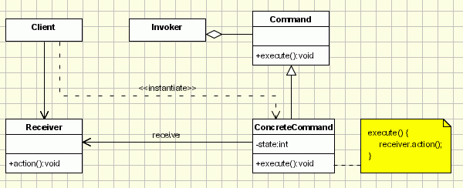
Structure

Slide 9
Participants
Command - declares an interface for executing an operation;
ConcreteCommand - extends the Command interface, implementing the Execute method by invoking the corresponding operations on Receiver. It defines a link between the Receiver and the action.
Client - creates a ConcreteCommand object and sets its receiver;
Invoker - asks the command to carry out the request;
Receiver - knows how to perform the operations;

Slide 10
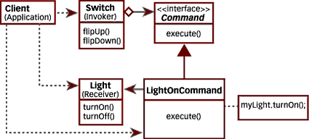
Example (ref: http://www.javaworld.com/javaworld/javatips/jw-javatip68.html?page=2)

Slide 11
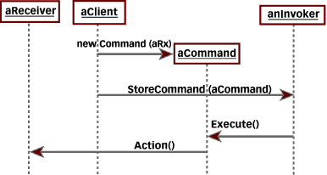
Sequence Diagram

Slide 12
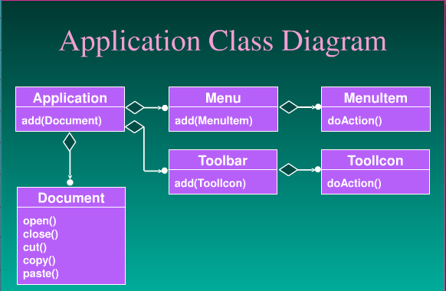
Example

Slide 13
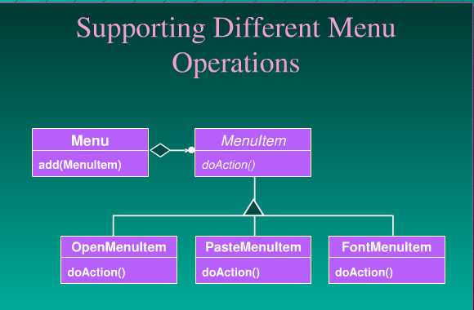
Example

Slide 14
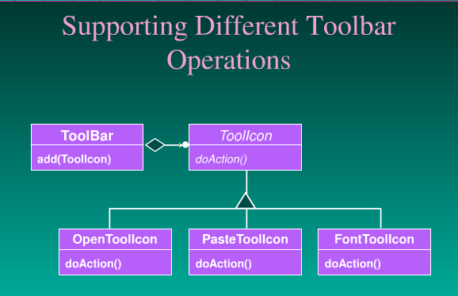
Example

Slide 15
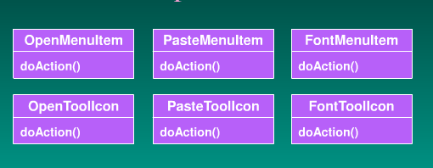
How do we get rid of this duplication?

Slide 16
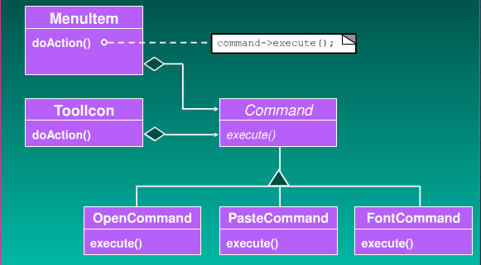
Adding a Command Class

Slide 17
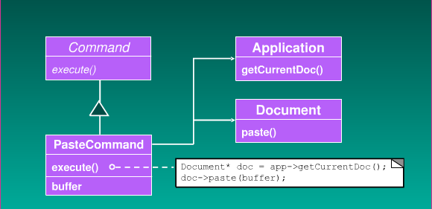
Implementing the Paste Command

Slide 18
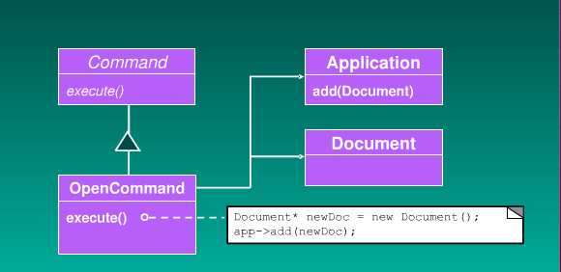
Implementing the Open Command

Slide 19
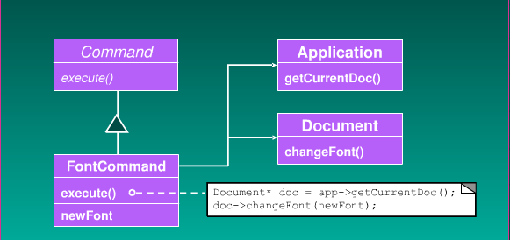
Implementing the Font Command

Slide 20
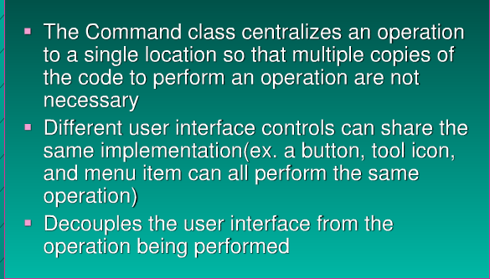
Advantages of Command Pattern

